Slide 1

软件工程专业英语
计算机科学学院
School of Computer Science
Unit 3：Planning the Project

Slide 2
Outline
Part 1, Dialogue: Software Project Planning
Part 2, Translating: Big Data

Slide 3
Part 1, Dialogue: Software Project Planning
Main content
时间分配
概要设计
详细设计
测试
强调了测试计划的重要性
讨论了需要安装的软件
进一步明确了分工

Slide 4
Jason: So much work to do.
Kevin: I think we need a formal project plan as our guideline.
Sharon: Yes, the first one is the time, which is one of the most important factors for a project. We need a schedule, especially, the deadline of our project.
Kevin: We have 40 days in total; the requirements acquirement has taken us 5 days already, so there are 35 days left.
Jason : Oh, it sounds really urgent.
Sharon: It seems that we should begin to program as soon as possible, right?
Jason: Although coding is a very central part of a software project, the most important thing is that we must first establish a proper schedule to control our progress and assure our deployment on time, I think.

Slide 5
Kevin: Yes. In the requirements phase, we will spent another 3 days to depict, analyze and model the requirements. After that, we will spend 3 days to complete the architectural design and it will take 5 days to accomplish the detailed design. Because of the effort applied to software design, code should follow with relatively little difficulty, and can be done within one week I think. Testing and subsequent debugging can account for about 10 days of software development effort.
Architecture design
体系结构设计、概要设计
Detailed design
详细设计
Gantt Chart
甘特图

Slide 6
Kevin: Yes. In the requirements phase, we will spent another 3 days to depict, analyze and model the requirements. After that, we will spend 3 days to complete the architectural design and it will take 5 days to accomplish the detailed design. Because of the effort applied to software design, code should follow with relatively little difficulty, and can be done within one week I think. Testing and subsequent debugging can account for about 10 days of software development effort.
account for 说明（原因、理由等）; 导致，引起;
（在数量、比例上）占; 对…负责
1. Computers account for 5% of the country's commercial electricity consumption. 计算机占去该国商业用电的5%。
2. Two things account for its occurrence.
发生这件事的原因有两个。
3. Can you account for the money you spent?
你能与我说明一下那钱都花在哪了？

Slide 7
Jason: Actually, testing should not be seen as an activity which starts only after the coding phase is complete, with the limited purposes of defecting failure. Indeed, planning for testing should start with the early stages of the requirement process, and test plans and procedures must be systematically and continuously developed, and possibly refined, as development proceeds. During coding, we can perform the unit testing at the same time. It will save much time and obtain better testing effects I think. Finally, we can perform a validation test by working with the customer to find out if the software developed is valid for the customer and make sure that the customer is getting what they asked for.

Slide 8
Sharon: By the way, we need three computers and must install the software which the customer requires with a uniform version as developing tools. That is Microsoft Visual Studio 2012 for a development platform and Microsoft SQL Server 2012 as a database management system.
Jason: We need a network as well.
Kevin: Ok, I will prepare the development environment for us as soon as possible. Then, we must assign some management responsibilities to everyone. Sharon, you are responsible for document management. Jason, you take charge of change management. And I will be in charge of the Software Quality Assurance. OK?
assign to 分配给; 指定; 确定; 归因于
1. In the list, select the command you want to assign to a shortcut key combination.
在列表中，选择要为其分配快捷键组合的命令。
2. You can access your volume though the drive letter or path you assign to it.
您可以通过指派的驱动器号或路径来访问卷。

Slide 9
Kevin: Ok, I have noted everything which we referred to just now, and will complete a project plan within two days.
refer to 参考; 指的是; 涉及; 适用于
1. Please refer to the right-hand column of page 200 of this dictionary.
请参看这本词典第二百页右面一栏。
2. This is a technical question, which I will have to refer to our technical department.
这是一个技术性的问题，我得找我们的技术部门。
3. These "more complex methods" are what I will refer to as artificial intelligences, or AIs.
这些”更复杂的方法“是我将称为的人工智能，也称AI。

Slide 10
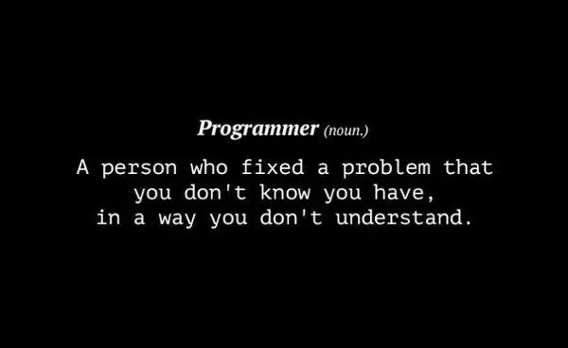

Slide 11
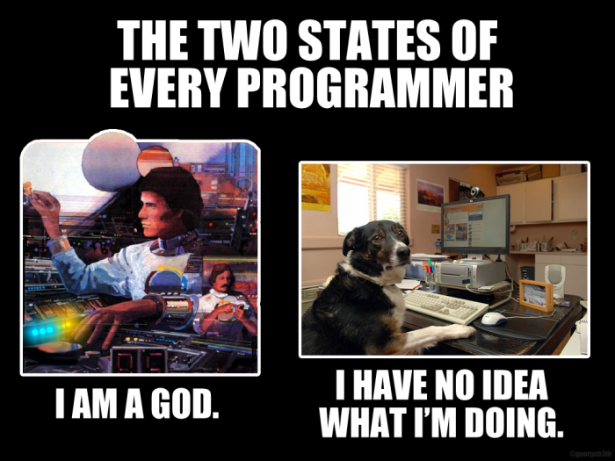

Slide 12
Outline
Part 1, Dialogue: Software Project Planning
Part 2, Translating: Big Data

Slide 13
The 1st paragraph
Up until about five years ago, most data collected by organizations consisted of structured transaction data that could easily fit into rows and columns of relational database management systems. Since then, there has been an explosion of beta from Web traffic, E-mail messages, and social media content (Tweets, status messages), even music playlist, as well as machine generated data from sensors. These data may be unstructured or semi-structured and thus not suitable for relational database products that organize data in the form of columns and rows. The popular term “big data” refers to this avalanche of digital data flowing into firms around the world largely from websites and Internet click string data. Some examples of “big data” challenges are analyzing 12 terabytes of tweets created each day to improve your understanding of consumer sentiment towards your products; 100 million E-mails in order to place appropriate ads alongside the E-mail messages; or 500 million call detail records to find patterns of fraud and churn. …,…
structured 结构化的
unstructured 非结构化的
semi-structured 半结构化的
relational database management systems
关系型数据库管理系统

Slide 14
The 1st paragraph
Up until about five years ago, most data collected by organizations consisted of structured transaction data that could easily fit into rows and columns of relational database management systems. Since then, there has been an explosion of data from Web traffic, E-mail messages, and social media content (Tweets, status messages), even music playlist, as well as machine generated data from sensors. These data may be unstructured or semi-structured and thus not suitable for relational database products that organize data in the form of columns and rows. The popular term “big data” refers to this avalanche of digital data flowing into firms around the world largely from websites and Internet click string data. Some examples of “big data” challenges are analyzing 12 terabytes of tweets created each day to improve your understanding of consumer sentiment towards your products; 100 million E-mails in order to place appropriate ads alongside the E-mail messages; or 500 million call detail records to find patterns of fraud and churn. …,…
an explosion of 爆发；爆炸；扩张，激增
In recent years, both the web and the enterprise have seen an explosion of data.
最近几年中，web和企业已经见证了数据膨胀。

Slide 15
The 1st paragraph
Up until about five years ago, most data collected by organizations consisted of structured transaction data that could easily fit into rows and columns of relational database management systems. Since then, there has been an explosion of beta from Web traffic, E-mail messages, and social media content (Tweets, status messages), even music playlist, as well as machine generated data from sensors. These data may be unstructured or semi-structured and thus not suitable for relational database products that organize data in the form of columns and rows. The popular term “big data” refers to this avalanche（[ˈævəlɑːnʃ]，纷至沓来，雪崩）of digital data flowing into firms around the world largely from websites and Internet click string data. Some examples of “big data” challenges are analyzing 12 terabytes of tweets created each day to improve your understanding of consumer sentiment （观点，情绪） towards your products; 100 million E-mails in order to place appropriate ads alongside the E-mail messages; or 500 million call detail records to find patterns of fraud and churn （粗制滥糙）. …,…

Slide 16
The 1st paragraph
Some examples of “big data” challenges are analyzing 12 terabytes of tweets created each day to improve your understanding of consumer sentiment towards your products；(analyzing) 100 million emails in order to place appropriate ads alongside the email messages; or (analyzing) 500 million call detail records to find patterns of fraud and churn.
“大数据”带来的挑战如：通过分析每天产生的12兆兆字节的微博数据来更好地了解用户对你的产品的看法；分析1亿封邮件以便在邮件旁边投放合适的广告；分析5亿条呼叫记录来寻找诈骗和粗制滥造的方式。
Up until about five years ago, most data collected by organizations consisted of structured transaction data that could easily fit into rows and columns of relational database management systems. Since then, there has been an explosion of beta from Web traffic, E-mail messages, and social media content (Tweets, status messages), even music playlist, as well as machine generated data from sensors. These data may be unstructured or semi-structured and thus not suitable for relational database products that organize data in the form of columns and rows. The popular term “big data” refers to this avalanche（[ˈævəlɑːnʃ]，纷至沓来，雪崩）of digital data flowing into firms around the world largely from websites and Internet click string data. Some examples of “big data” challenges are analyzing 12 terabytes of tweets created each day to improve your understanding of consumer sentiment （观点，情绪） towards your products; 100 million E-mails in order to place appropriate ads alongside the E-mail messages; or 500 million call detail records to find patterns of fraud and churn （粗制滥糙）. …,…

Slide 17
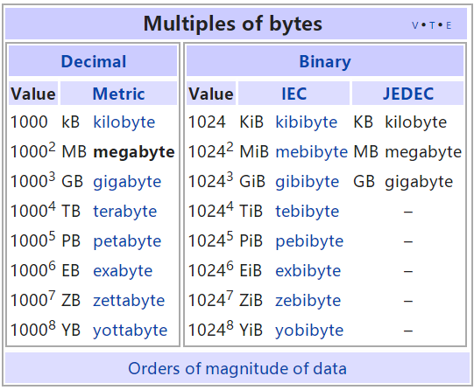
The 1st paragraph
…,… Big data and the tools needed to deal with it really started with Google and other search engines. Google’s problem: it has to deal with 500 million searches a day, and within milliseconds, display search results and place ads. For fun, do a search on “big data” and you will see Google respond with more than 1 billion results in 38 milliseconds (about a third of a second). That's much faster than you can read this sentence! Big data usually refers to data in the petabyte and exabyte range—in other words, billions to trillions of records, all from different sources. Big data are produced in much larger quantities and much more rapidly than traditional data. Even though “tweets” are limited to 140 characters each, Twitter generates more than 8 terabytes of data daily. According to the IDC technology research firm, data is more than doubling every two years, so the amount of data available to organizations is skyrocketing. Making sense out of it quickly in order to gain a market advantage is critical.

Slide 18
The 1st paragraph
…,… Big data and the tools needed to deal with it really started with Google and other search engines. Google’s problem: it has to deal with 500 million searches a day, and within million milliseconds, display search results and place ads. For fun, do a search on “big data” and you will see Google respond with more than 1 billion results in 38 milliseconds (about a third of a second). That‘s much faster than you can read this sentence! Big data usually refers to data in the petabyte and exabyte range—in other words, billions to trillions of records, all from different sources. Big data are produced in much larger quantities and much more rapidly than traditional data. Even though “tweets” are limited to 140 characters each, Twitter generates more than 8 terabytes of data daily. According to the IDC technology research firm, data is more than doubling every two years, so the amount of data available to organizations is skyrocketing (突升，猛涨). Making sense (理解) out of it quickly in order to gain a market advantage is critical.
in large/vast quantities 大量，大规模
Do you give a discount if we buy it in large quantities?
如果我们购买的数量多，你能不能给打折扣？。

Slide 19
The 1st paragraph
…,… Big data and the tools needed to deal with it really started with Google and other search engines. Google’s problem: it has to deal with 500 million searches a day, and within million milliseconds, display search results and place ads. For fun, do a search on “big data” and you will see Google respond with more than 1 billion results in 38 milliseconds (about a third of a second). That‘s much faster than you can read this sentence! Big data usually refers to data in the petabyte and exabyte range—in other words, billions to trillions of records, all from different sources. Big data are produced in much larger quantities and much more rapidly than traditional data. Even though “tweets” are limited to 140 characters each, Twitter generates more than 8 terabytes of data daily. According to the IDC technology research firm, data is more than doubling every two years, so the amount of data available to organizations is skyrocketing (突升，猛涨). Making sense out of it quickly in order to gain a market advantage is critical.
make sense (out of …) 有意义; 理解; 讲得通;
Even without knowing any Ruby or anything about object-oriented programming I bet you can make sense out of the following code examples, which are pieces of actual Ruby on Rails code.
即使不知道任何Ruby或任何物件导向语言，我打赌你也可以对下列的程式码范例有感觉，以下是实际的Ruby on Rails程式码。

Slide 20
The 2nd paragraph
Businesses are interested in big data because they contain more patterns and interesting anomalies ([əˈnɒməli], 异常，反常) than smaller data sets，with the potential to provide new insights into customer behavior, weather patterns，financial market activity or other phenomena.
独立分词结构，作补充说明
企业对“大数据”感兴趣，是因为它们与更小的数据集相比包含了更多的模式与特例，因而具备提供新的针对顾客行为、天气模式、金融市场活动或其他现象相关信息的潜力。

Slide 21
The 3rd paragraph
However, to derive business value from these data, organizations need a new technology and tools capable of managing and analyzing nontraditional data along with their traditional enterprise data.
along with 跟…一起
I enclose two tickets along with this letter.
我随信附上两张票。

Slide 22
The 4th paragraph
To handle on structured and semi-structured data in vast quantities, as well as structured data, organizations are using Hadoop. Hadoop is an open source software framework managed by Apache Software Foundation that enables distributed parallel [ˈpærəlel] processing of huge amount of data across inexpensive computers. It breaks a big data problem down into sub-problems, distributes them among up to thousands of inexpensive computer processing nodes, and then combines the result into a smaller dataset that is easier to analyze. You have probably used Hadoop to find the best airfare on the Internet, get directions to a restaurant, search on Google, or connect with a friend on Facebook.
huge amounts of
large quantities of
large volumes of
大量的
You can compress huge amounts of data on to a CD-ROM.
可以把大量的数据压缩到一张CD-ROM上

Slide 23
The 4th paragraph
To handle on structured and semi-structured data in vast quantities, as well as structured data, organizations are using Hadoop. Hadoop is an open source software framework managed by Apache Software Foundation that enables distributed parallel processing of huge amount of data across inexpensive computers. It breaks a big data problem down into sub-problems, distributes them among up to thousands of inexpensive computer processing nodes, and then combines the result into a smaller dataset that is easier to analyze. You have probably used Hadoop to find the best airfare on the Internet, get directions to a restaurant, search on Google, or connect with a friend on Facebook.

Slide 24
The 5th paragraph
Hadoop can process large quantities of any kind of data, including structured transactional data, loosely structured data such as Facebook and Twitter feeds, complex data such as Web server log files, and unstructured audio and video data. Hadoop runs on a cluster of inexpensive servers, and processors can be added or removed as needed. Companies use Hadoop to analyze very large volumes of data as well as for a staging area for unstructured and semi-structured data before they are loaded into a data warehouse. Facebook stores much of its data on its massive Hadoop cluster, which holds an estimated 100 pedabytes about 10,000 times more information than the library of Congress. Yahoo uses hadoop to track user behavior so it can modify its homepage to fit user interests. Life sciences research firm NextBio uses Hadoop and HBase to process data for pharmaceutical companies conducting genomic research. Top database vendors such as IBM, HP, Oracle and Microsoft have their own Hadoop software distributions. Other vendors offer tools for moving data into and out of Hadoop or for analyzing data within Hadoop.

Slide 25
The 5th paragraph
Hadoop can process large quantities of any kind of data, including structured transactional data, loosely structured data such as Facebook and Twitter feeds, complex data such as Web server log files, and unstructured audio and video data. Hadoop runs on a cluster of inexpensive servers, and processors can be added or removed as needed. Companies use Hadoop to analyze very large volumes of data as well as for a staging area for unstructured and semi-structured data before they are loaded into a data warehouse. Facebook stores much of its data on its massive Hadoop cluster, which holds an estimated 100 pedabytes about 10,000 times more information than the library of Congress. Yahoo uses hadoop to track user behavior so it can modify its homepage to fit user interests. Life sciences research firm NextBio uses Hadoop and HBase to process data for pharmaceutical companies conducting genomic research. Top database vendors such as IBM, HP, Oracle and Microsoft have their own Hadoop software distributions. Other vendors offer tools for moving data into and out of Hadoop or for analyzing data within Hadoop.

Slide 26
The 5th paragraph
Hadoop can process large quantities of any kind of data, including structured transactional data, loosely structured data such as Facebook and Twitter feeds, complex data such as Web server log files, and unstructured audio and video data. Hadoop runs on a cluster of inexpensive servers, and processors can be added or removed as needed. Companies use Hadoop to analyze very large volumes of data as well as for a staging area for unstructured and semi-structured data before they are loaded into a data warehouse. Facebook stores much of its data on its massive Hadoop cluster, which holds an estimated 100 pedabytes about 10,000 times more information than the library of Congress. Yahoo uses hadoop to track user behavior so it can modify its homepage to fit user interests. Life sciences research firm NextBio uses Hadoop and HBase to process data for pharmaceutical [ˌfɑːrməˈsuːtɪkl] companies conducting genomic research. Top database vendors such as IBM, HP, Oracle and Microsoft have their own Hadoop software distributions. Other vendors offer tools for moving data into and out of Hadoop or for analyzing data within Hadoop.
pharmaceutical
adj.制药的;配药的;卖药的
n.药物
genomic
adj.基因组的;染色体组的

